Slide 1
Exclusive π⁰ electroproduction in the resonance region.
Maurizio Ungaro, Kyungseon Joo, Nick Markov
University of Connecticut
Jefferson Laboratory
for the CLAS collaboration

Slide 2
Outline
Introduction
Experiment Overview
Preliminary Results
Summary

Slide 3
N* Program in CLAS
Map the γNN* electro-couplings as a function of photon virtuality with a combined analysis of electroproduction channels
Access active degrees of freedom at various distances
Explore the non-perturbative strong interactions responsible for nucleon formation and the origin of quark confinement
Example of non-perturbative approaches: LQCD, DSE, LCSR
Notes:
The results that I’m about to show provides data so far missing for the pi0 channel in the first and second resonance region between q2 of 0.4 and 6 GeV2
Real motivation is lack of data at high q2
At CLAS an intense program is underway with single, double meson electroproduction
Impressive results already, pi+, double meson production… this presentation regards the upcoming pi0, eta results.
A longstanding challenge in Hadronic Physics is to understand the spectroscopy of these resonant states, including their electromagnetic and strong decays, within a framework consistent with QCD.
If you want to take on this challenge of understanding the role of quarks and gluon in nuclei you have to step into the domain of relativistic quantum field theory where the key phenomena can only be understood with non-perturbative methods.
LQCD:
New techniques allow the calculation of baryon spectra not only in the ground state (proton, roper, S11) but also of the EXCITED states.
Data are from H.W. Lin calculations that involves for the first time radial excitations in the calculation of the form factors, and a way to extract signal to noise that help the extraction at high Q2
At low q2 the unphysical pion masses how large deviation from the experiment. This also might be due to coupling of the meson cloud with the resonances.
However at higher q2 results, given the limitation of these calculation, are promising.
DSE:
The framework of DSE is a framework that has marked success on DCSB study and hadrons observables… and these guys are just getting started.
An extensive, international study of nucleon electromagnetic form factors has been recently completed by Cloet et al (argonne). In their calculations dressed quarks are the degrees of freedom and correlations are expressed with di-quarks. The diquark current depends on their charge radius.
Here’s the key: we can use high precision measurement of nucleon-resonance transition form factor to chart the momentum evolution of the dressed-quark mass. In particular, the transition between current and constituent quark domains. This is believed to happen between 5-10 GeV2
An example of the role of transition form factor is the N->Delta. The calculation reported here, by Cloet, Bentz and Thomas. The FF lacks significant strength at 0 (its value should be 3) but qualitatively it’s very promising. This calculation is done without the running of the dress quark mass with its momentum. Following this calculation, the framework of the Faddeev equation and the dressed-quark mass variation predicted by the DSE, will be performed.
LCSR
An approach that allows quantitative descriptions of form factor using soft non perturbative contribution is the LCSR.
One of the feature of LCSR that I’d like to emphasize here is the ability of connecting the DA to the transition form factors.
The LCSR expect to converge at Q2>2… here the prediction looks to describe the data reasonably well. As the LQCD results are expected to improve, these results will have to improve – for example, include NLO radiative corrections.

Slide 4
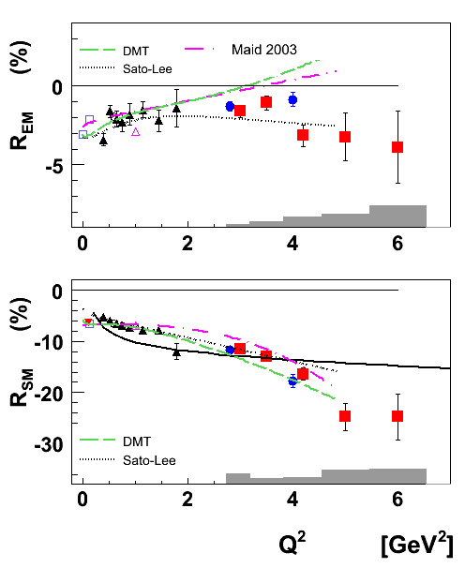
π⁰ electro-production
Single π⁺, π⁰ production
π⁺ in the resonance region
e’
π⁰ in the Delta
π⁺, π⁰
Missing:
π⁰ in the resonance region
e
γ_{v}
N*, △*
Q²: 0.4 → 1.0 GeV²
W: 1.1 → 1.8 GeV
~40000 data points
p
n, p’
M. Ungaro Phys.Rev.Lett.97:112003,2006
K. Park Phys.Rev.C77:015208,2008
I.G. Aznauryan Phys.Rev.C78:045209,2008
Q²: 2.0 → 6.5 GeV²
W: 1.1 → 2.0 GeV
~75000 data points
Q²: 1.6 → 5.4 GeV²
W: 1.1 → 1.8 GeV
58000 data points
0 ← Q² → 6
Q²: 2 → 6.5 GeV²
W: 1.1 → 1.4 GeV
7200 data points
Maurizio Ungaro
Nick Markov, UCONN
116000 Data Points
1.1 ← W → 2.0
Notes:
A longstanding challenge in Hadronic Physics is to understand the spectroscopy of these resonant states, including their electromagnetic and strong decays, within a framework consistent with QCD.
At CLAS an intense program is underway with single, double meson electroproduction
Impressive results already, pi+, double meson production… this presentation regards the upcoming pi0, eta results.
will extract asymmetries as well
Why high Q²?
Constraints on short range behavior-correlations.
Simplifications in treating reaction mechanism.
Measurement. Cross sections, asymmetries.
Extraction of elastic and resonance form factors.
Impact physics.
eta cpuples only wth I=1/2

Slide 5
Experiment Overview
σ = σ(W,Q²,cos(θ∗))
dσ/dΩ∗ = σ_{T} + εσ_{L} + εσ_{TT}sin²θcos2φ + √2ε(ε+1)σ_{LT}sinθcosφ
detect:
Electron, Proton
extract:
Cross sections, Structure Functions
Beam Spin Asymmetries
Helicity amplitudes and their Q² dependence
N
Notes:
We must understand the Hadrons Structure in order to
understand why the world is the way it is.
Elastic scattering and transitions to excited states are equally
fundamental and together constrain physics inputs.
They put different constraints depending on spin and parity
and structure of ground and excited states.

Slide 6
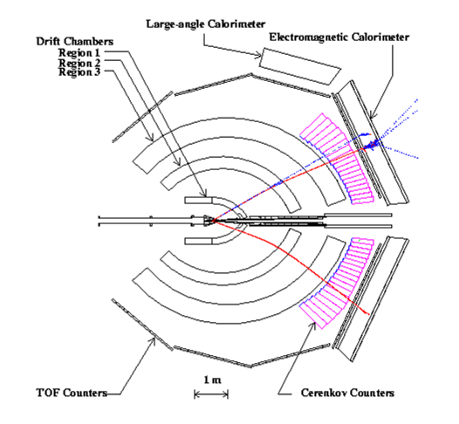
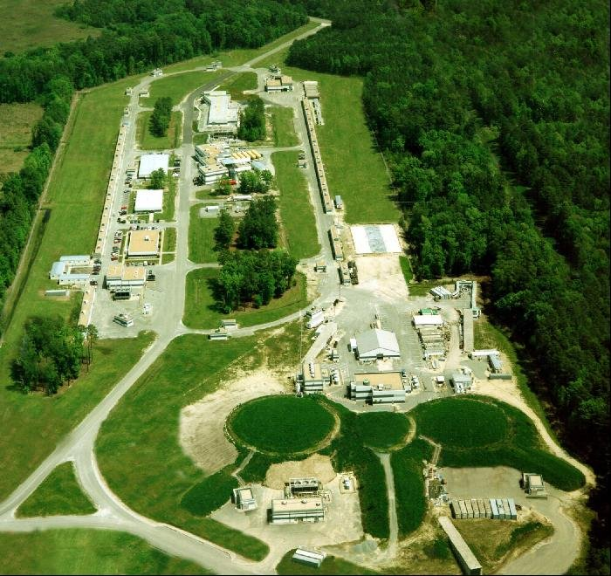
Experiment Overview
October 2001 – January 2002
Beam Energy = 5.75 GeV
Current Intensity = 10nA (10³⁴cm⁻²s⁻¹)
3.7 Billions triggers
December 2002 – January 2003
Beam Energy = 2.036 GeV
Current Intensity = 10nA (10³⁴cm⁻²s⁻¹)
1.5 Billions triggers
Notes:
We must understand the Hadrons Structure in order to
understand why the world is the way it is.
Elastic scattering and transitions to excited states are equally
fundamental and together constrain physics inputs.
They put different constraints depending on spin and parity
and structure of ground and excited states.
How electron is detected, and protons, fiducial cut, then how to detect pi0 missing mass technique, not 2 gamma, because of resolution b.h. need to be removed
CLAS = 6 sectors
azimuthal phi is divided in 6 sectors

Slide 7
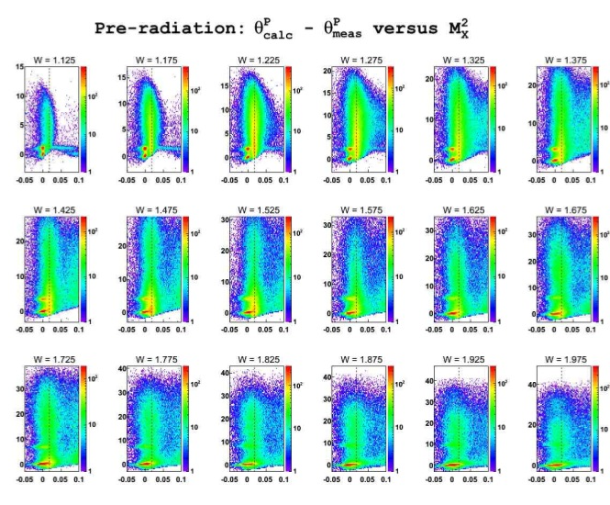
Analysis Overview
B.H. Separation:
The typical angle between the emitted photon and the electron in B.H. processes is θ ∼ m/E

Slide 8
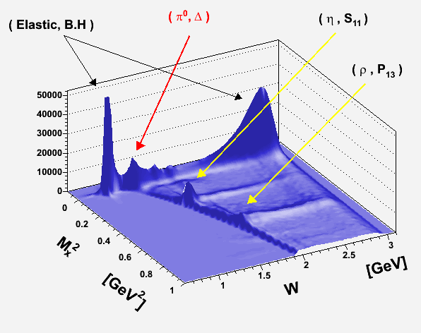
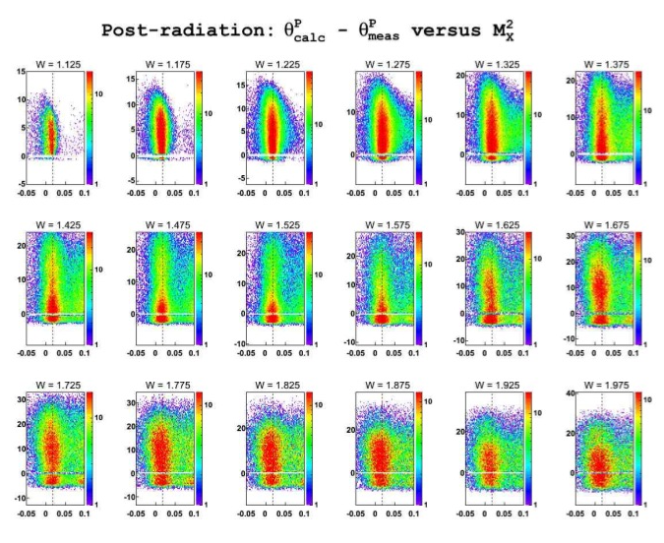
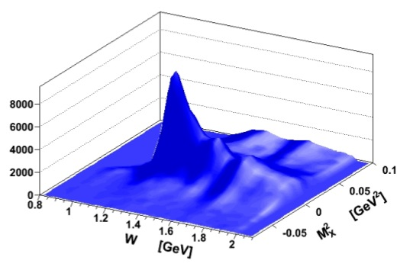
Analysis Overview
B.H. Separation:
The typical angle between the emitted photon and the electron in B.H. processes is θ ∼ m/E

Slide 9
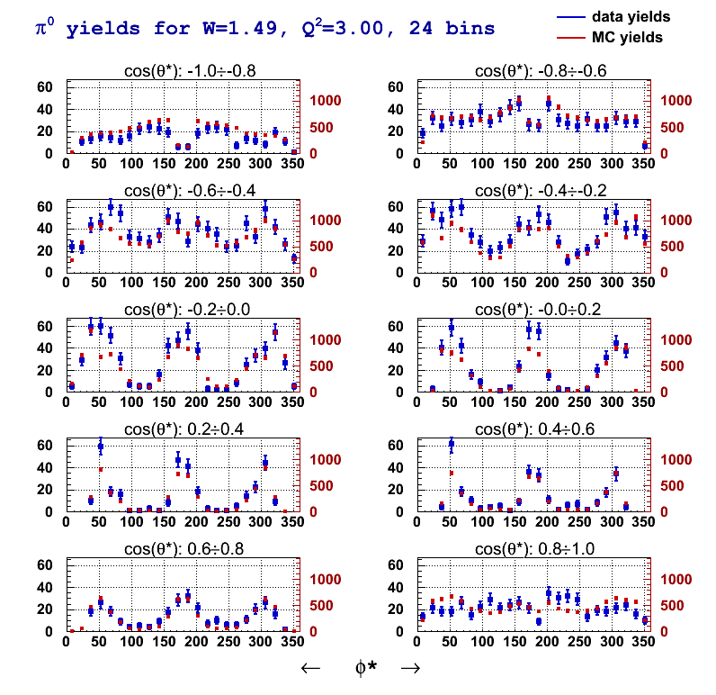
Analysis Overview
24 φ bins
200M Generated Events
MAID2007
AAO_RAD
Electron ID
Proton ID
Vertex Correction, Selections
Electron Fiducial Cut
Proton Fiducial Cut
Timing Resolution Match
Momentum Resolution Match
Drift Chamber Efficiencies
π⁰ selection

Slide 10
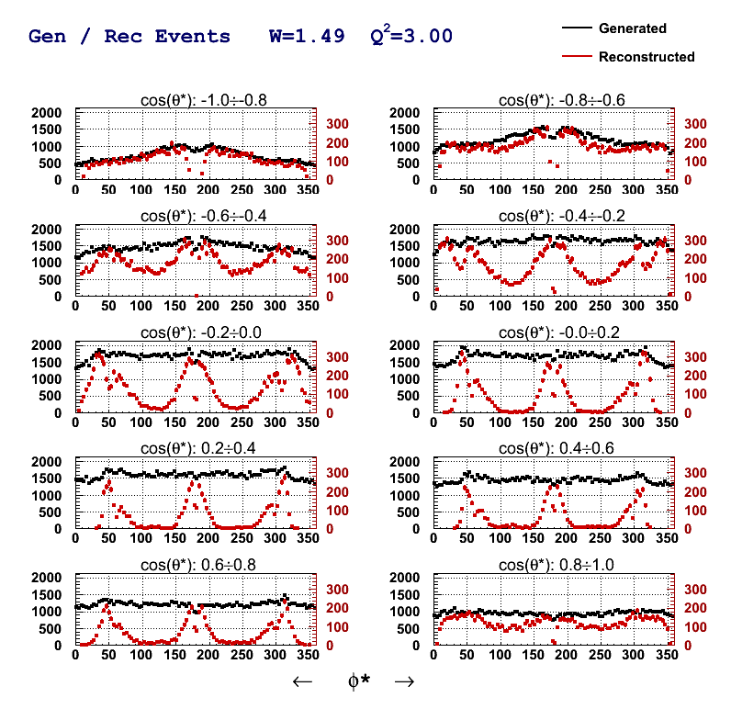
Analysis Overview
96 φ bins
200M Generated Events
MAID2007
AAO_RAD
Electron ID
Proton ID
Vertex Correction, Selections
Electron Fiducial Cut
Proton Fiducial Cut
Timing Resolution Match
Momentum Resolution Match
Drift Chamber Efficiencies
π⁰ selection

Slide 11
Analysis Overview
Radiative Correction
exclurad
(Afanasev, Akushevich, Burkert, Joo)
Input: Exclusive cross section
No peaking approximation
No soft-hard photon discrimination
Radiation of 4 SF with angular dependence of each one (exclusive electro-production)
W=1.29

Slide 12
Analysis Overview
Radiative Correction
exclurad
(Afanasev, Akushevich, Burkert, Joo)
Input: Exclusive cross section
No peaking approximation
No soft-hard photon discrimination
Radiation of 4 SF with angular dependence of each one (exclusive electro-production)
W=1.63

Slide 13
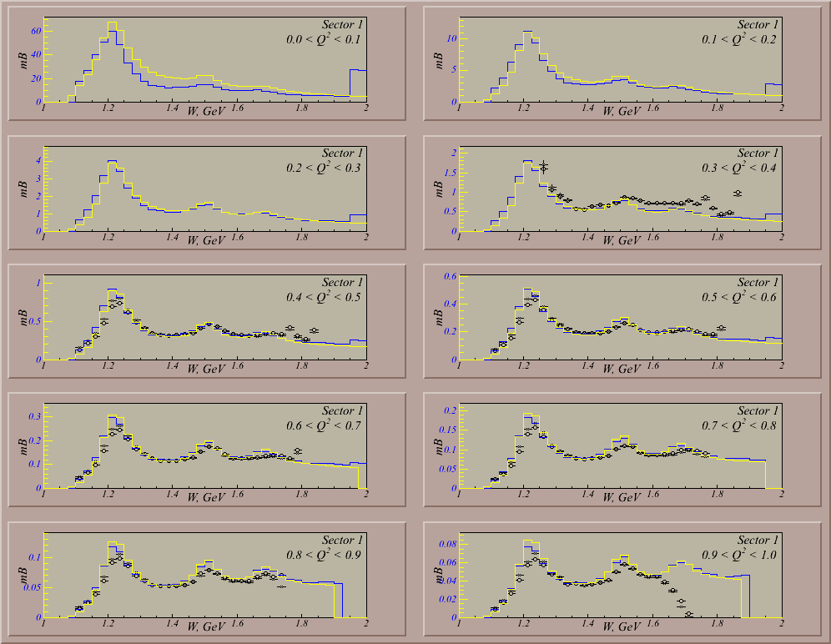
Analysis Overview
Normalization check:
Good electron PID, fiducial cut
Good acceptance from simulation
Vertex Correction, Cuts
Kinematic Corrections
Elastic Scattering
Inclusive scattering
Data
Keppel
Brasse

Slide 14
Analysis Overview
S1
S2
Normalization check:
Good electron PID, fiducial cut
Good acceptance from simulation
Vertex Correction, Cuts
Kinematic Corrections
Elastic Scattering
Inclusive scattering
W [GeV]
W [GeV]
S3
S4
W [GeV]
W [GeV]
Data
Keppel
Brasse
S5
S6
W [GeV]
W [GeV]

Slide 15
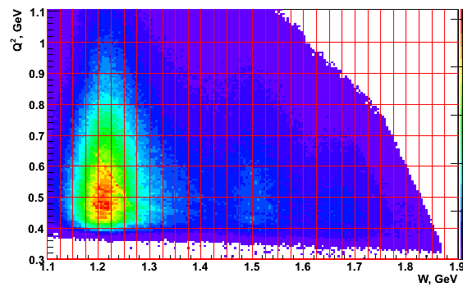
Preliminary Results, Low Q²
Variable Bin size bins
W, GeV 0.025 28 1.1 1.8
Q², GeV² 0.1 6 0.4 1.0
cosθ 0.2 10 -1 1
φ 15º 24 0º 360º
40320 points

Slide 16
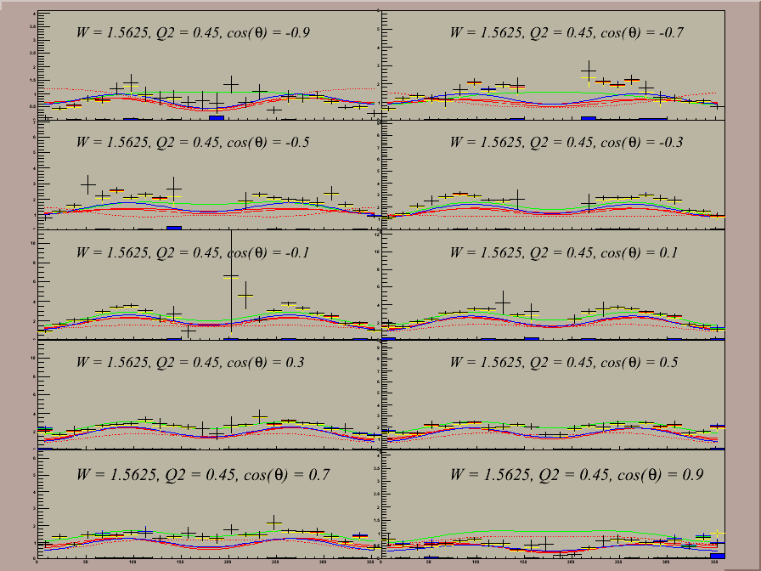
Preliminary Results, Low Q²
W = 1.5625 GeV
Q² = 0.45 GeV²
CLAS Preliminary
Variable Bin size bins
W, GeV 0.025 28 1.1 1.8
Q², GeV² 0.1 6 0.4 1.0
cosθ 0.2 10 -1 1
φ 15º 24 0º 360º

Slide 17
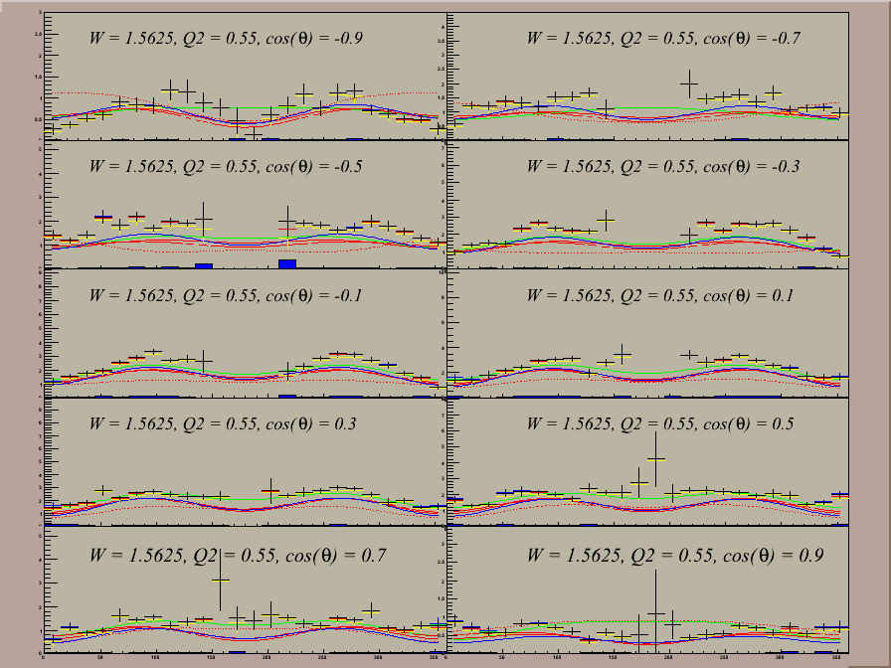
Preliminary Results, Low Q²
W = 1.5625 GeV
Q² = 0.55 GeV²
CLAS Preliminary
Variable Bin size bins
W, GeV 0.025 28 1.1 1.8
Q², GeV² 0.1 6 0.4 1.0
cosθ 0.2 10 -1 1
φ 15º 24 0º 360º

Slide 18
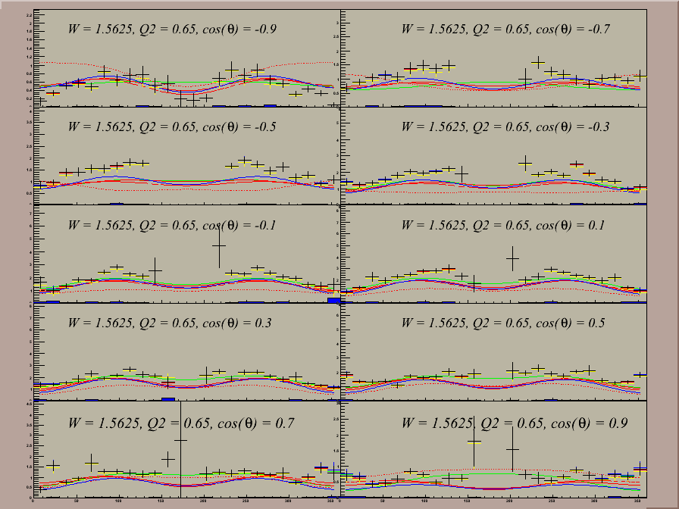
Preliminary Results, Low Q²
W = 1.5625 GeV
Q² = 0.65 GeV²
CLAS Preliminary
Variable Bin size bins
W, GeV 0.025 28 1.1 1.8
Q², GeV² 0.1 6 0.4 1.0
cosθ 0.2 10 -1 1
φ 15º 24 0º 360º

Slide 19
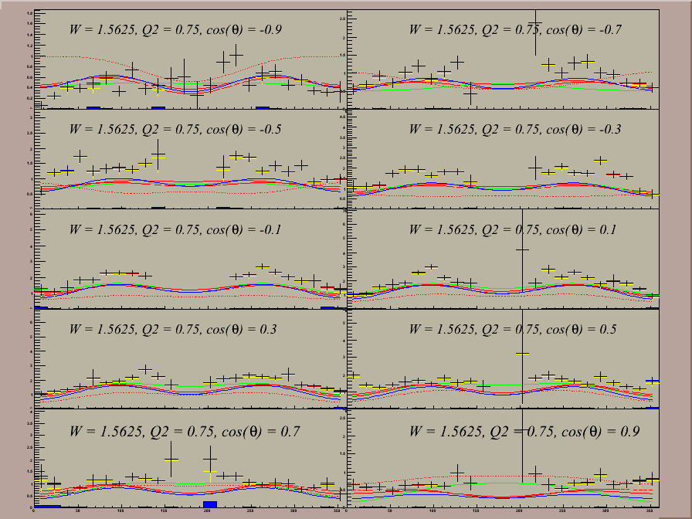
Preliminary Results, Low Q²
W = 1.5625 GeV
Q² = 0.75 GeV²
CLAS Preliminary
Variable Bin size bins
W, GeV 0.025 28 1.1 1.8
Q², GeV² 0.1 6 0.4 1.0
cosθ 0.2 10 -1 1
φ 15º 24 0º 360º

Slide 20
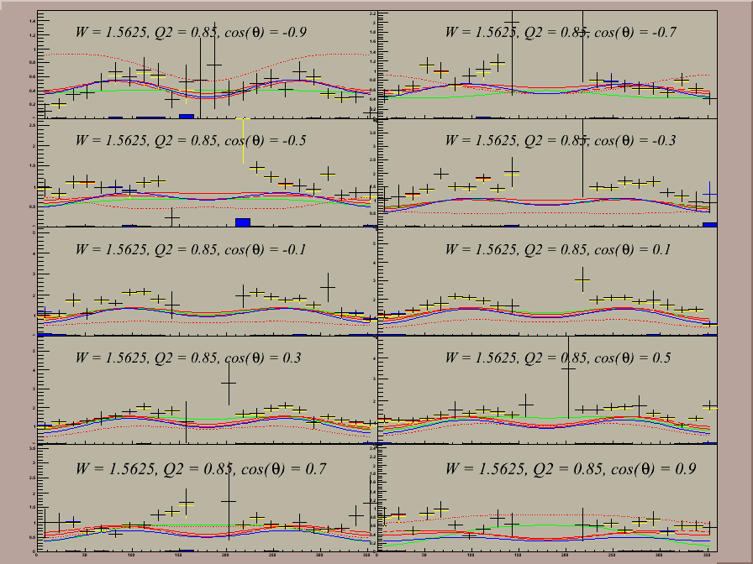
Preliminary Results, Low Q²
W = 1.5625 GeV
Q² = 0.85 GeV²
CLAS Preliminary
Variable Bin size bins
W, GeV 0.025 28 1.1 1.8
Q², GeV² 0.1 6 0.4 1.0
cosθ 0.2 10 -1 1
φ 15º 24 0º 360º

Slide 21
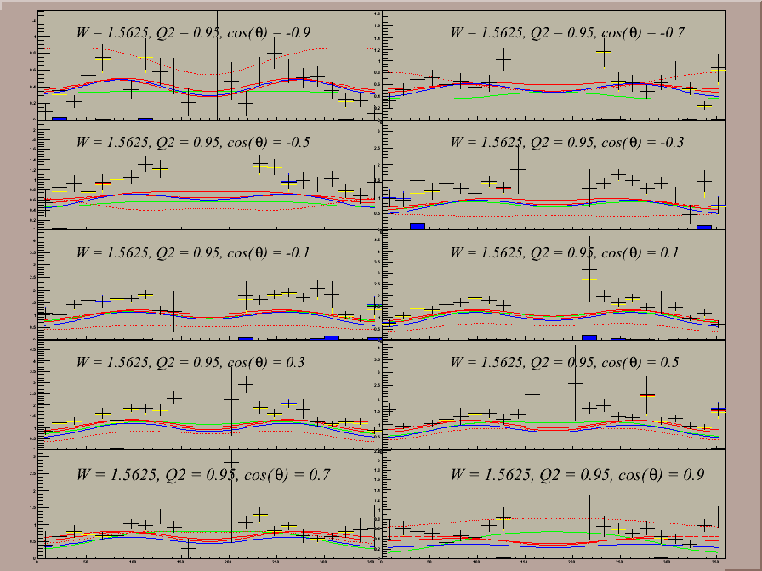
Preliminary Results, Low Q²
W = 1.5625 GeV
Q² = 0.95 GeV²
CLAS Preliminary
Variable Bin size bins
W, GeV 0.025 28 1.1 1.8
Q², GeV² 0.1 6 0.4 1.0
cosθ 0.2 10 -1 1
φ 15º 24 0º 360º

Slide 22
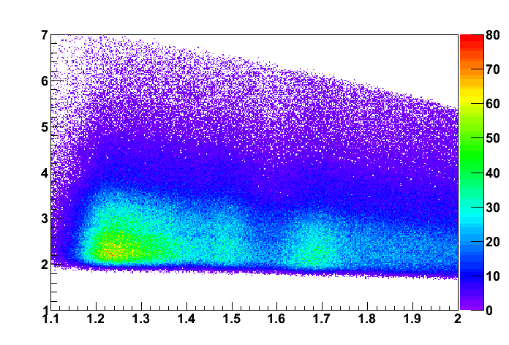
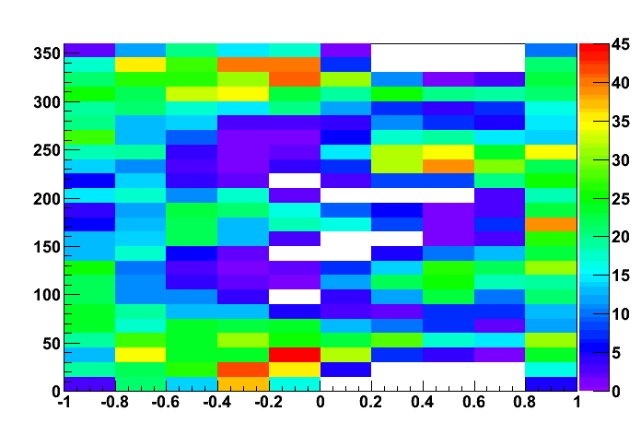
Preliminary Results, High Q²
W=1.59 Q²=3.5
φ [deg]
Q² [GeV²]
W [GeV]
Cos(θ)
45 bins in W, ΔW=20 MeV
7 bins in Q² DQ²/Q² ~ 0.18
10 bins in cos(θ*)
24, 48, 96 bins in φ*
Total: 75600 CS points
Notes:
may asubstantially affect other channels with lower cross section (lambda k, sigma k)

Slide 23
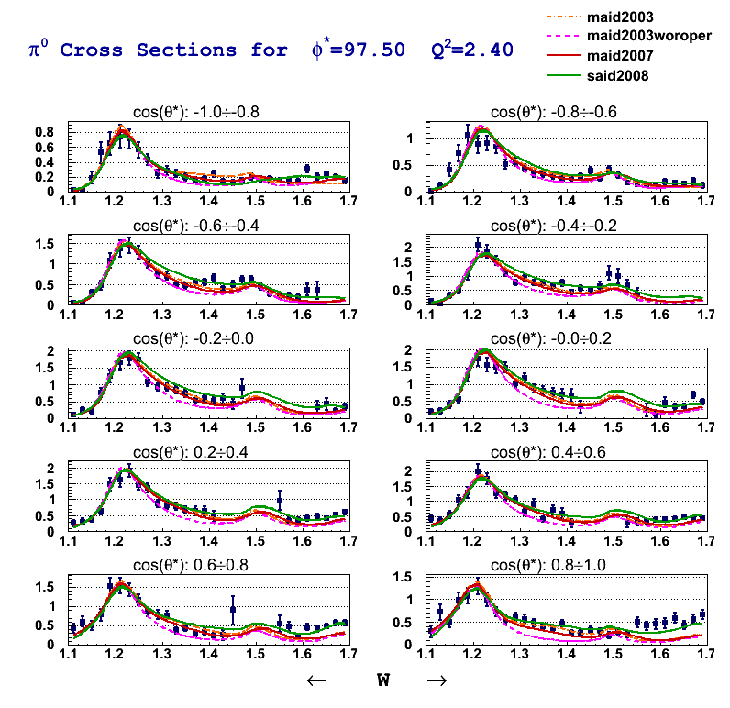
Preliminary Results, High Q²
CLAS Preliminary
350 points
out of 75K
⬅ μb/srad ➔
Q² = 2.4 GeV²
φ = 97.5⁰ ± 7.5⁰

Slide 24
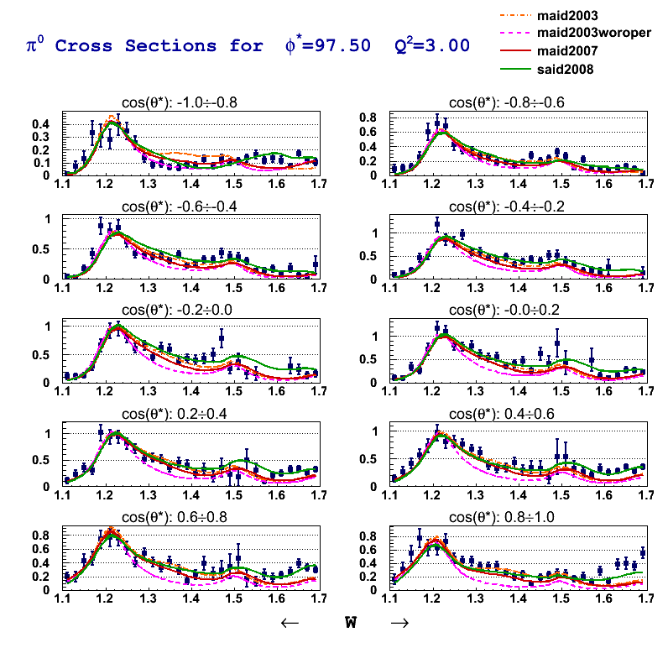
Preliminary Results, High Q²
CLAS Preliminary
350 points
out of 75K
⬅ μb/srad ➔
Q² = 3.0 GeV²
φ = 97.5⁰ ± 7.5⁰

Slide 25
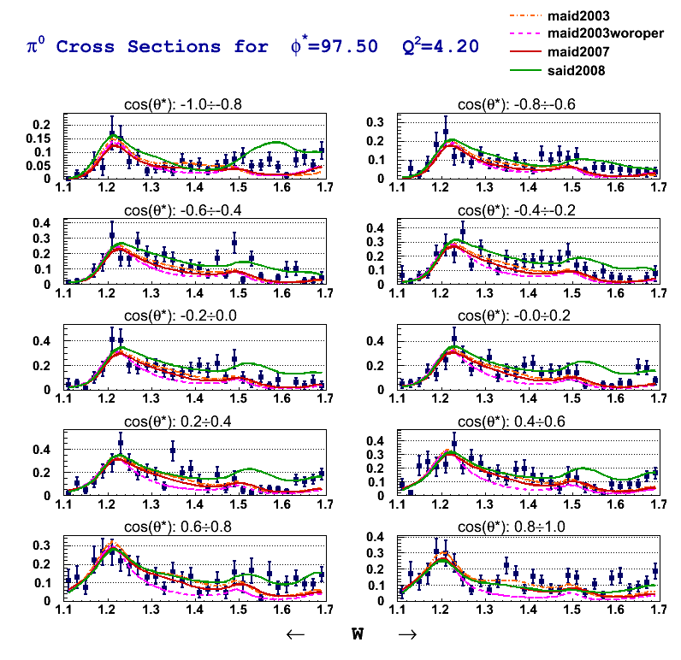
Preliminary Results, High Q²
CLAS Preliminary
350 points
out of 75K
⬅ μb/srad ➔
Q² = 4.2 GeV²
φ = 97.5⁰ ± 7.5⁰

Slide 26
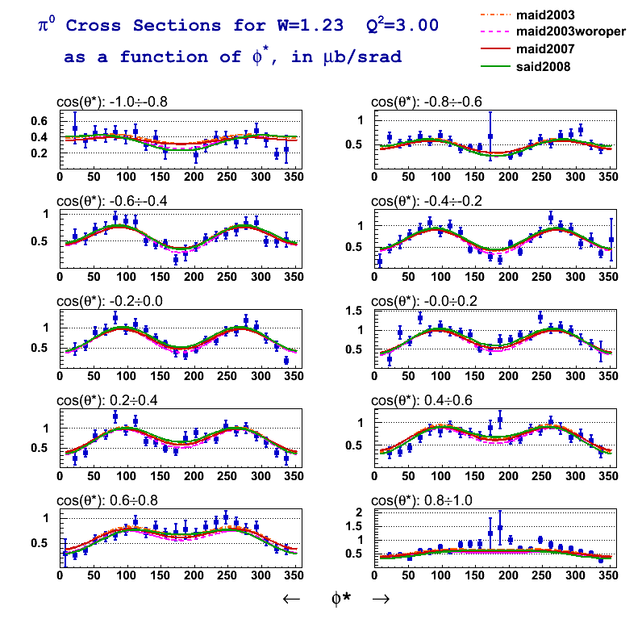
Preliminary Results, High Q²
dσ/dΩ∗ = σ_{T} + εσ_{L} + εσ_{TT}sin²θcos2φ + √2ε(ε+1)σ_{LT}sinθcosφ
CLAS Preliminary
240 points
out of 75K
W = 1.23 GeV²
Q² = 3.0 GeV²

Slide 27
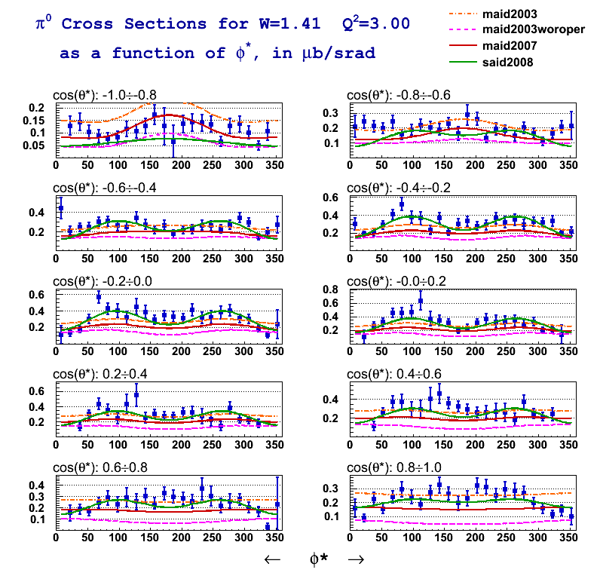
Preliminary Results, High Q²
dσ/dΩ∗ = σ_{T} + εσ_{L} + εσ_{TT}sin²θcos2φ + √2ε(ε+1)σ_{LT}sinθcosφ
CLAS Preliminary
240 points
out of 75K
W = 1.41 GeV²
Q² = 3.0 GeV²

Slide 28
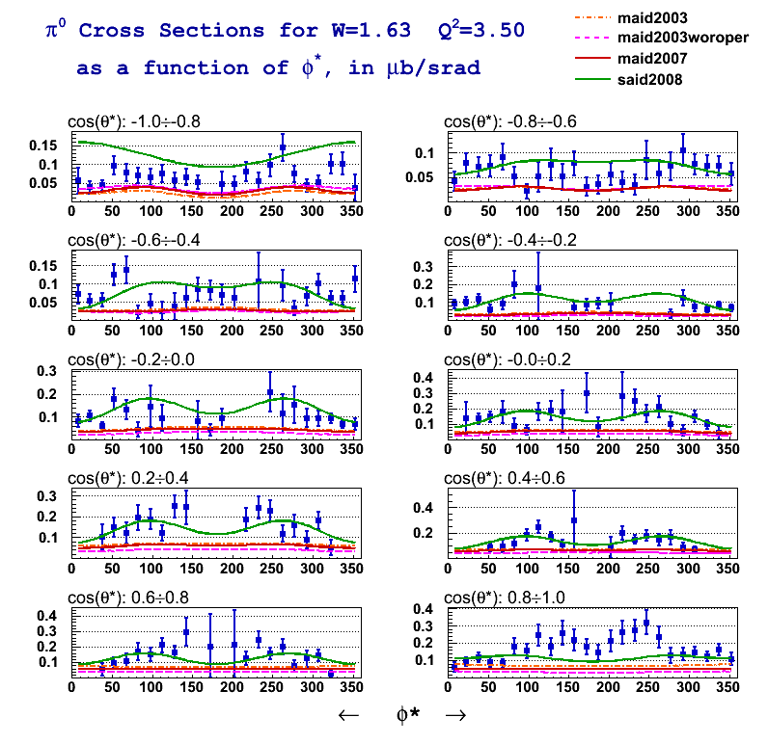
Preliminary Results, High Q²
dσ/dΩ∗ = σ_{T} + εσ_{L} + εσ_{TT}sin²θcos2φ + √2ε(ε+1)σ_{LT}sinθcosφ
CLAS Preliminary
240 points
out of 75K
W = 1.63 GeV²
Q² = 3.0 GeV²

Slide 29
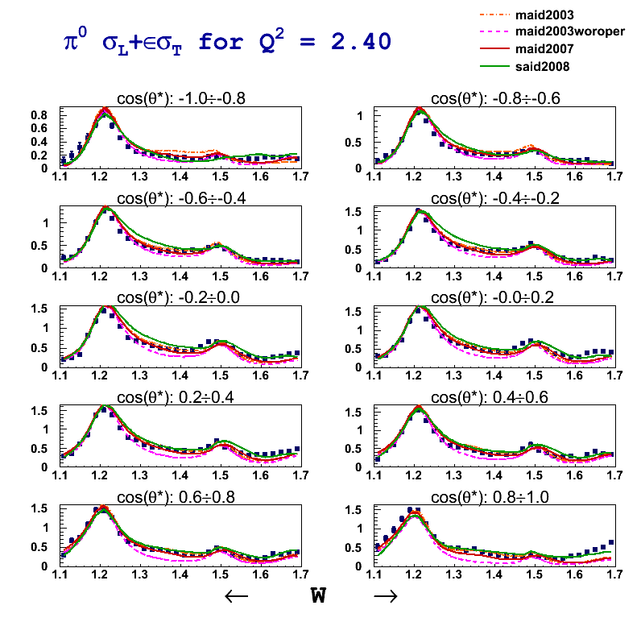
Preliminary Results, High Q²
dσ/dΩ∗ = σ_{T} + εσ_{L} + εσ_{TT}sin²θcos2φ + √2ε(ε+1)σ_{LT}sinθcosφ
CLAS Preliminary
Q² = 2.4 GeV²

Slide 30
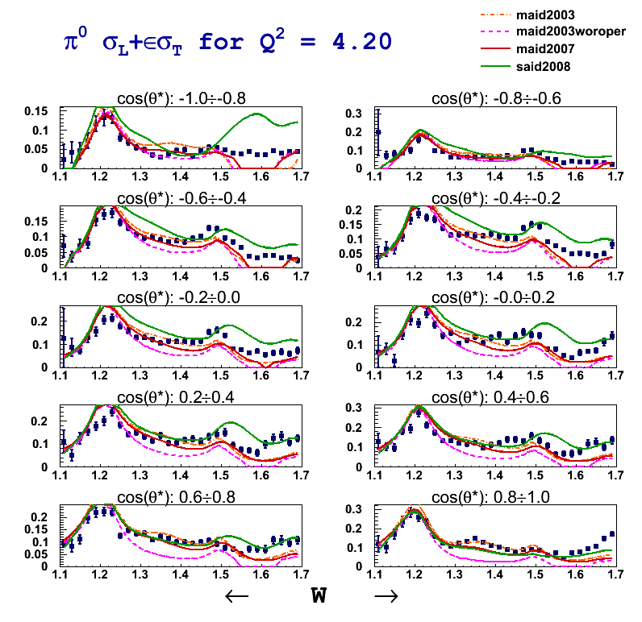
Preliminary Results
dσ/dΩ∗ = σ_{T} + εσ_{L} + εσ_{TT}sin²θcos2φ + √2ε(ε+1)σ_{LT}sinθcosφ
CLAS Preliminary
Q² = 4.2 GeV²

Slide 31
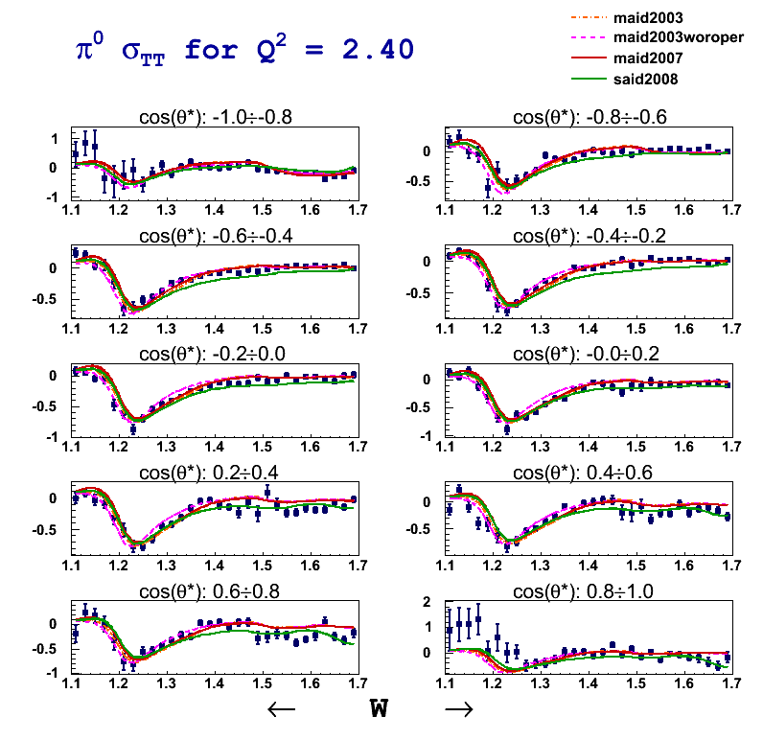
Preliminary Results, High Q²
dσ/dΩ∗ = σ_{T} + εσ_{L} + εσ_{TT}sin²θcos2φ + √2ε(ε+1)σ_{LT}sinθcosφ
CLAS Preliminary
Q² = 2.4 GeV²

Slide 32
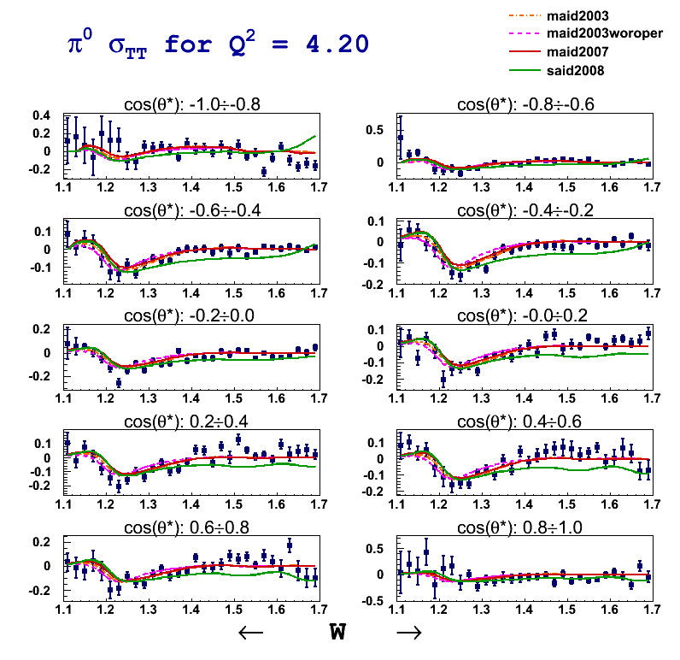
Preliminary Results, High Q²
dσ/dΩ∗ = σ_{T} + εσ_{L} + εσ_{TT}sin²θcos2φ + √2ε(ε+1)σ_{LT}sinθcosφ
CLAS Preliminary
Q² = 4.2 GeV²

Slide 33
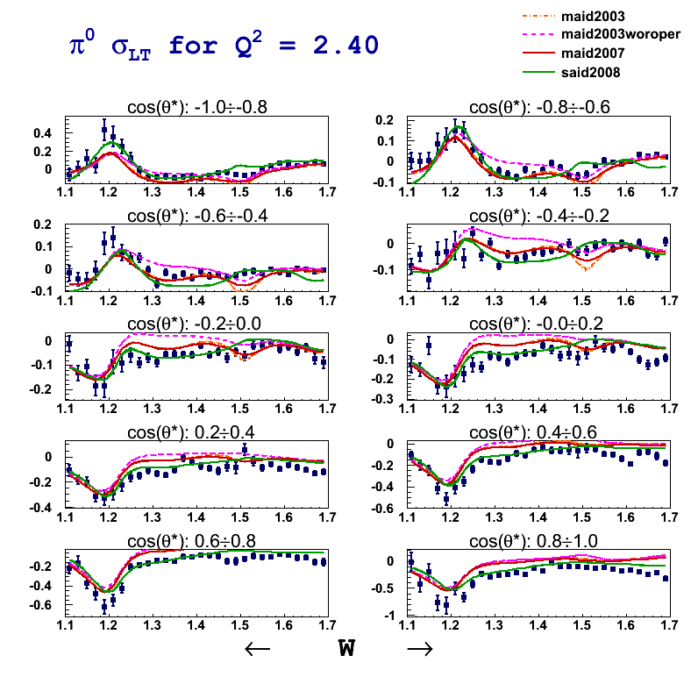
Preliminary Results, High Q²
dσ/dΩ∗ = σ_{T} + εσ_{L} + εσ_{TT}sin²θcos2φ + √2ε(ε+1)σ_{LT}sinθcosφ
CLAS Preliminary
Q² = 2.4 GeV²

Slide 34
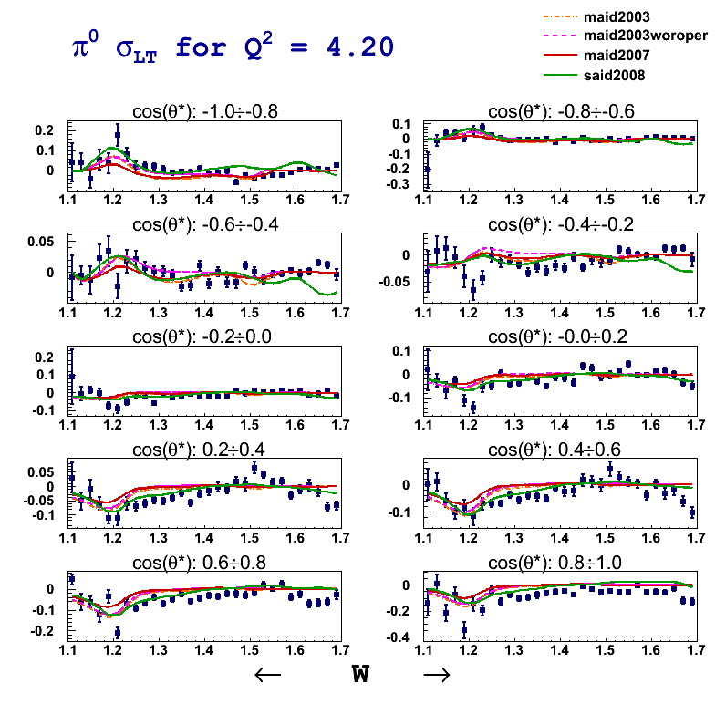
Preliminary Results, High Q²
dσ/dΩ∗ = σ_{T} + εσ_{L} + εσ_{TT}sin²θcos2φ + √2ε(ε+1)σ_{LT}sinθcosφ
CLAS Preliminary
Q² = 4.2 GeV²

Slide 35
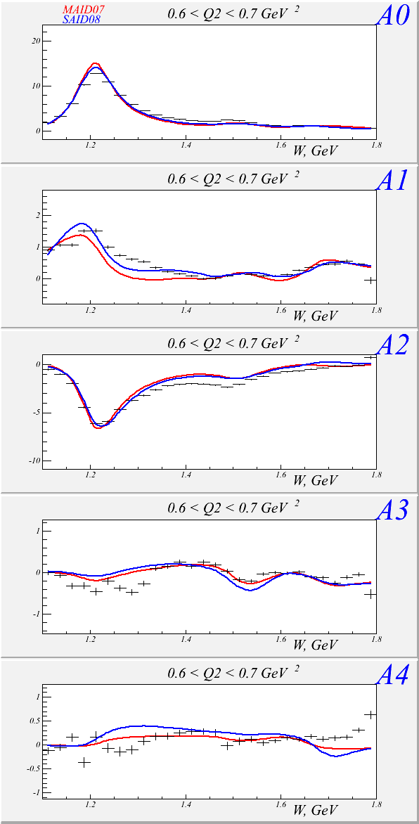
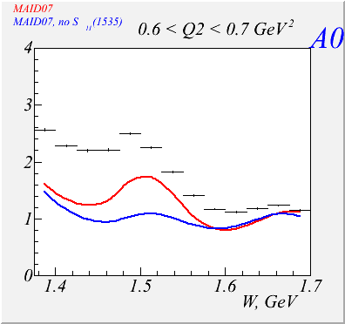
Preliminary Results, Low Q²
A₀: Contains E₀₊ , sensitive to S₁₁
CLAS Preliminary
MAID07
Red: with S11
Blue: w/o S11

Slide 36
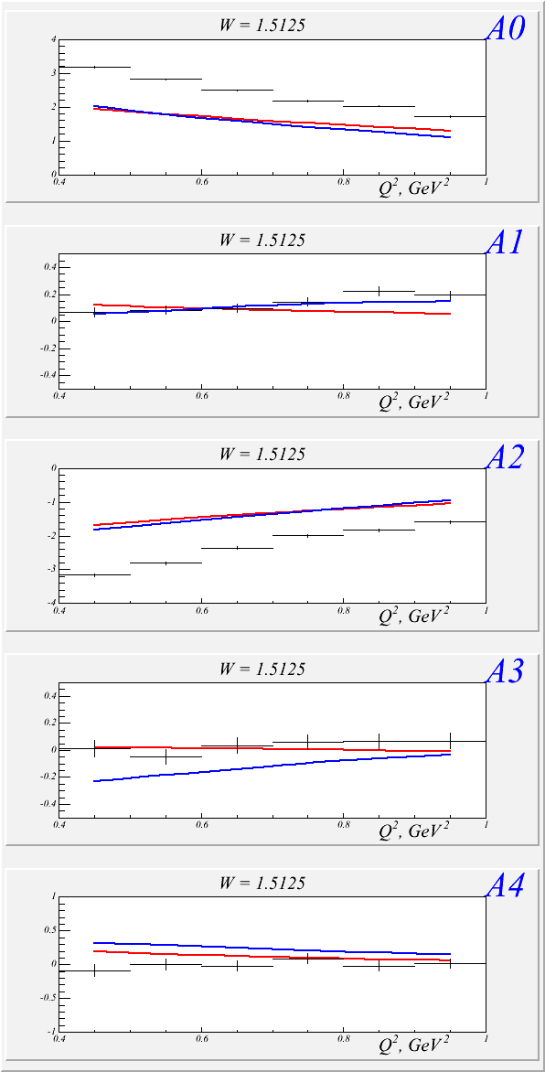
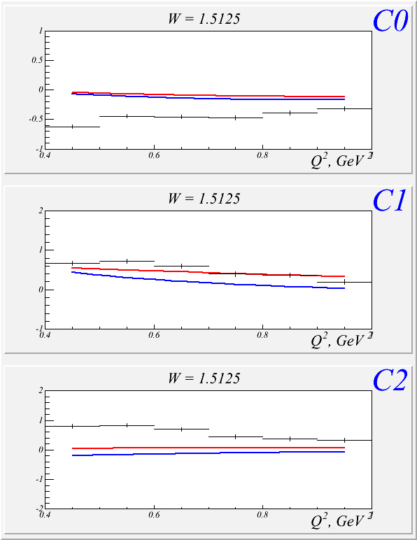
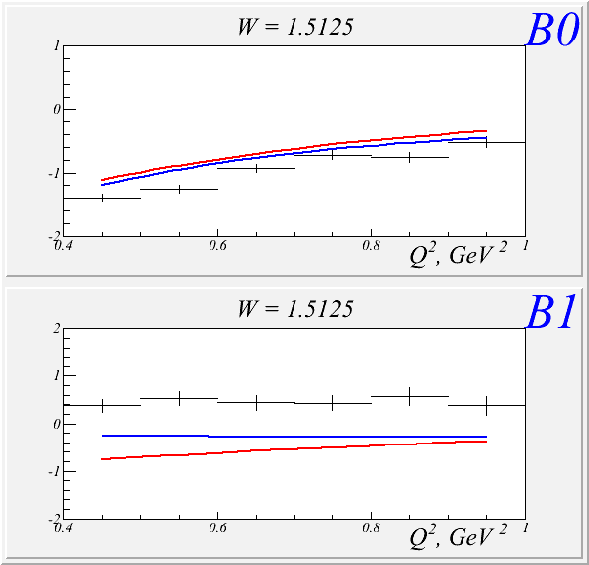
Preliminary Results, Low Q²
CLAS Preliminary
Notes:
Continuity
Gives an idea of the precision of the data at various q2. These does not correspond one to one to helicity amplitudes of course, but gives a pretty good idea of the error bars at various q2

Slide 37
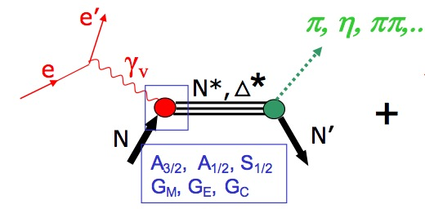
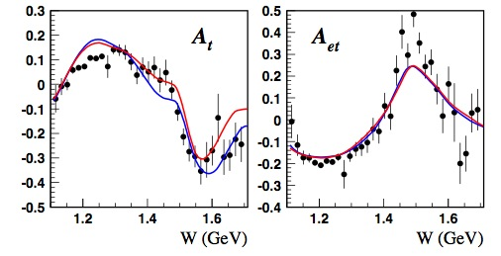
Analysis Tools
Single pseudoscalar meson production, e.g. Nπ, Nη
Unitary isobar model (UIM)
non-resonant amplitudes incorporate nucleon and meson Born terms, vector meson exchanges, Regge terms at high energy
resonant terms incorporate relativistic BW amplitude with energy-dependent widths
full amplitude unitarized in K-matrix approximation
Fixed-t dispersion relations (DR)
resonance amplitudes constructed in same way as in UIM
non-resonant amplitudes from Born terms and dispersion relation.
Notes:
Two conceptually different approaches, DR and UIM provides consistent results

Slide 38
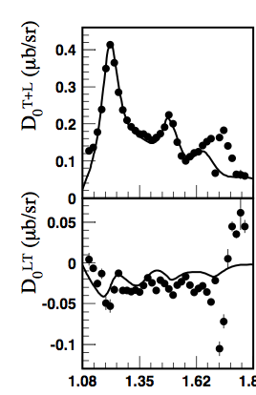
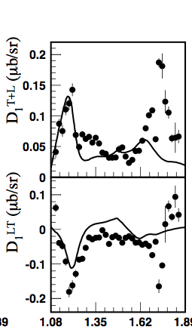
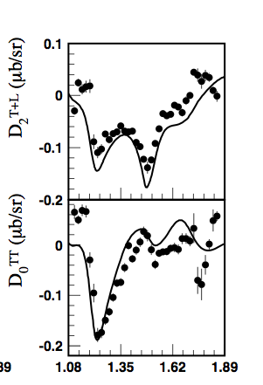
Preliminary Results, High Q²
Legendre Coefficients: Combined π⁰ and π⁺ analysis with DR model
dσ/dΩ∗ = σ_{T} + εσ_{L} + εσ_{TT}sin²θcos2φ + √2ε(ε+1)σ_{LT}sinθcosφ
Q² = 3.5 GeV²
CLAS Preliminary

Slide 39
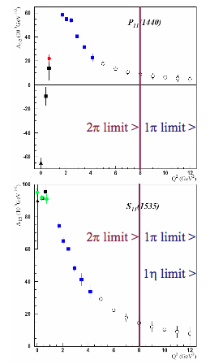
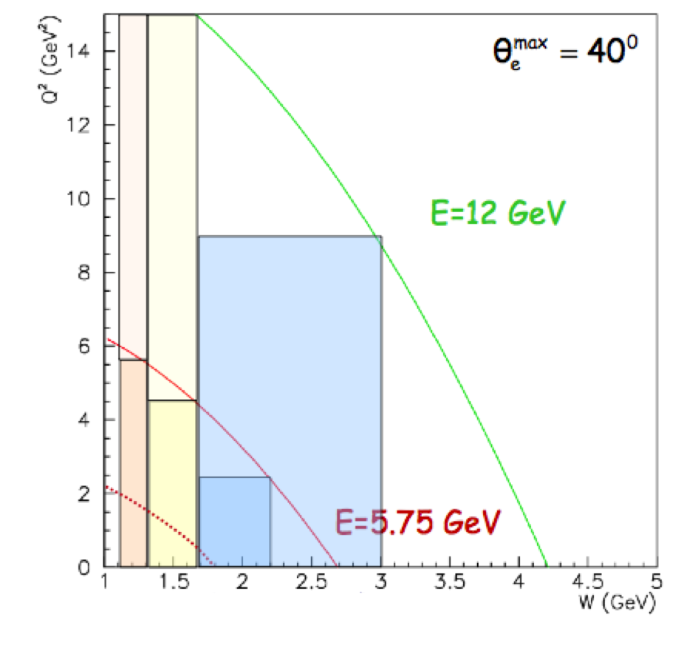
not so distant future…
60 Days at 10³⁵ cm⁻²s⁻¹
Notes:
The NSTAR program, coupled with the GPD program will allow us to make a complete, high definition 3d picture of the nucleon.

Slide 40
Summary, Outlook
116,000 data points to be added spanning Q² from 0.4 to 6 GeV²
To do list:
JANR, DR, SAID analysis
Analysis Review:
π⁰ (by this summer, both low and high Q²)
Access active degrees of freedom at various distances
Explore the non-perturbative strong interactions responsible for nucleon formation and the origin of quark confinement
CLAS Preliminary

Slide 41
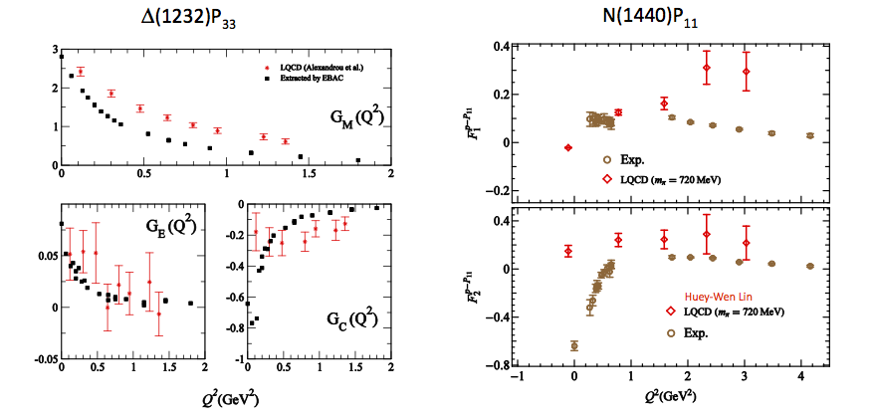
LQCD
C. Alexanrou
H.W. Lin
Notes:
LQCD:
New techniques allow the calculation of baryon spectra not only in the ground state (proton, roper, S11) but also, for the first time, of the EXCITED states.
Data are from H.W. Lin calculations that involves for the first time radial excitations in the calculation of the form factors, and a way to extract signal to noise that help the extraction at high Q2
At low q2 the unphysical pion masses how large deviation from the experiment. This also might be due to coupling of the meson cloud with the resonances.
However at higher q2 results, given the limitation of these calculation, are promising.
By the time of the upgrade LQCD calcula8ons of N* electrocouplings will be extended to Q2 = 10 GeV2 near the physical π-­‐mass as part of the commitment of the JLab LQCD and EBAC groups in support of this proposal.
DSE:
The framework of DSE is a framework that has marked success on DCSB study and hadrons observables… and these guys are just getting started.
An extensive, international study of nucleon electromagnetic form factors has been recently completed by Cloet et al (argonne). In their calculations dressed quarks are the degrees of freedom and correlations are expressed with di-quarks. The diquark current depends on their charge radius.
Here’s the key: we can use high precision measurement of nucleon-resonance transition form factor to chart the momentum evolution of the dressed-quark mass. In particular, the transition between current and constituent quark domains. This is believed to happen between 5-10 GeV2
An example of the role of transition form factor is the N->Delta. The calculation reported here, by Cloet, Bentz and Thomas. The FF lacks significant strength at 0 (its value should be 3) but qualitatively it’s very promising. This calculation is done without the running of the dress quark mass with its momentum. Following this calculation, the framework of the Faddeev equation and the dressed-quark mass variation predicted by the DSE, will be performed.
LCSR
An approach that allows quantitative descriptions of form factor using soft non perturbative contribution is the LCSR.
One of the feature of LCSR that I’d like to emphasize here is the ability of connecting the DA to the transition form factors.
The LCSR expect to converge at Q2>2… here the prediction looks to describe the data reasonably well. As the LQCD results are expected to improve, these results will have to improve – for example, include NLO radiative corrections.

Slide 42
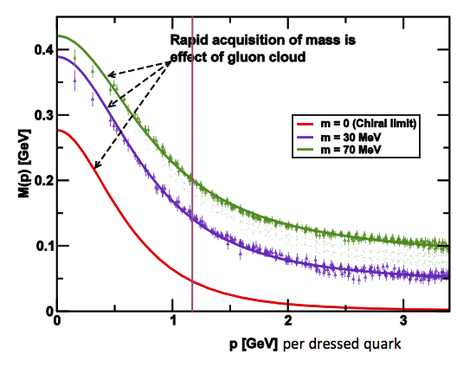
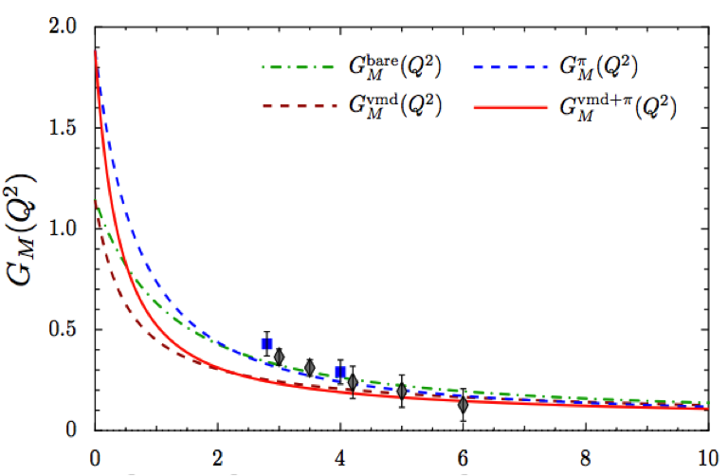
DSE
We can use high precision measurement of nucleon-resonance transition form factor to chart the momentum evolution of the dressed-quark mass.
Cloet, Bentz and Thomas
JLAB 12
Notes:
DSE:
The framework of DSE is a framework that has marked success on DCSB study and hadrons observable. The DCSB is the only non-perturbative mechanism that prescribe a
Non-zero
An extensive, international study of nucleon electromagnetic form factors has been recently completed by Cloet et al (argonne). In their calculations dressed quarks are the degrees of freedom and correlations are expressed with di-quarks. The diquark current depends on their charge radius.
Here’s the key: we can use high precision measurement of nucleon-resonance transition form factor to chart the momentum evolution of the dressed-quark mass. In particular, the transition between current and constituent quark domains. This is believed to happen between 5-10 GeV2
An example of the role of transition form factor is the N->Delta. The calculation reported here, by Cloet, Bentz and Thomas. The FF lacks significant strength at 0 (its value should be 3) but qualitatively it’s very promising. This calculation is done without the running of the dress quark mass with its momentum. Following this calculation, the framework of the Faddeev equation and the dressed-quark mass variation predicted by the DSE, will be performed.
LCSR
An approach that allows quantitative descriptions of form factor using soft non perturbative contribution is the LCSR.
One of the feature of LCSR that I’d like to emphasize here is the ability of connecting the DA to the transition form factors.
The LCSR expect to converge at Q2>2… here the prediction looks to describe the data reasonably well. As the LQCD results are expected to improve, these results will have to improve – for example, include NLO radiative corrections.

Slide 43
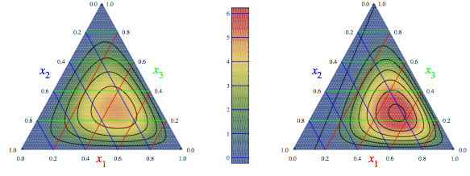
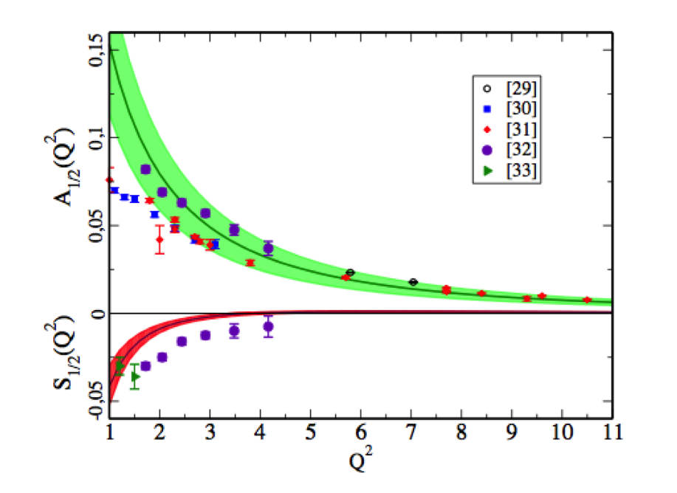
LCSR
Distribution Amplitudes ←→ Form Factors
difference in wave functions at origin of ground and S11(1535) states was observed for the first time in LQCD calculations with pion mass 280 MeV
Notes:
LCSR
An approach that allows quantitative descriptions of form factor using soft non perturbative contribution is the LCSR.
One of the feature of LCSR that I’d like to emphasize here is the ability of connecting the DA to the transition form factors.
Momentum fraction distribution of the proton ground state and the chiral partner, s11(1535)
The LCSR expect to converge at Q2>2… here the prediction looks to describe the data reasonably well. As the LQCD results are expected to improve, these results will have to improve – for example, include NLO radiative corrections.

Slide 44
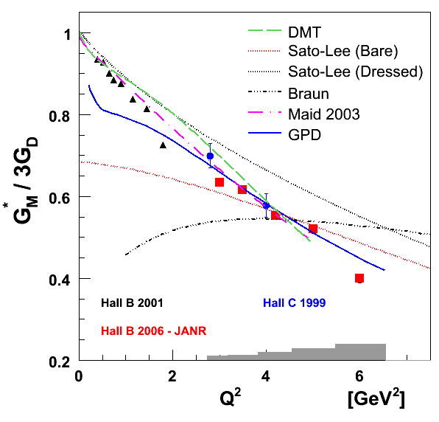
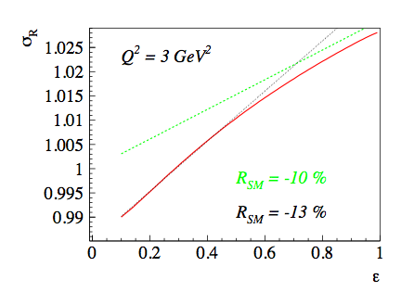
GPD, TPE
Large N_{C} limit: N→Δ GPD H_{M} is related to isovector elastic GPD E(x,ξ, t)
2γ corrections for the same values of RS M
Pascalutsa, Carlson, Vanderhaeghen
Notes:
LCSR
An approach that allows quantitative descriptions of form factor using soft non perturbative contribution is the LCSR.
One of the feature of LCSR that I’d like to emphasize here is the ability of connecting the DA to the transition form factors.
Momentum fraction distribution of the proton ground state and the chiral partner, s11(1535)
The LCSR expect to converge at Q2>2… here the prediction looks to describe the data reasonably well. As the LQCD results are expected to improve, these results will have to improve – for example, include NLO radiative corrections.

Slide 45
Transverse Charge Densities
L. Tiator, D. Drechsel, S.S. Kamalov, M. Vanderhaeghen
arXiv:0909.2335 [nucl-th]
N → Roper
N → S₁₁
N → D₁₃
Notes:
Transverse charge densities are calculated from the transition form factors as seen from a light front moving toward the baryon.
We can choose a particular frame where the virtual photon couples with one component of the quark current.
Left:
roper: unpolarized
S11 and D13: when p and N* have same light front helicity
right:
roper: polarized
S11 and D13: when p and N* have opposite light front helicity

